Slide 1

Mental Health Prediction for Kenyan university students

Slide 2

Overview
This project aims to develop a machine learning model that classifies statements and questions expressed by university students in Kenya when speaking about the mental health challenges they struggle with and come up with a chatbot that will be used for a prototype of a mental health chatbot designed specifically for university students.

Slide 3
Problem Statement
Despite resources in Kenyan universities growing immensely over the years, development of support services to students has not.Research has shown high levels of mental health problems among university students specifically depression and anxiety with the most affected group being students from poor backgrounds. The lack of or little provision for support services for such students results in dropouts and their inability to reach their full potential.
The use of technologies including machine learning and AI will potentially transform the delivery of mental health services in the coming years.This challenge aims to develop a machine learning model that classifies statements and questions expressed by university students in Kenya when speaking about the mental health challenges they struggle with and come up with a chatbot that will be used for a prototype of a mental health chatbot designed specifically for university students.

Slide 4
Objectives
To develop a machine learning model that classifies statements and questions expressed by university students in Kenya when speaking about the mental health challenges they struggle with
To help universities establish mental health support and wellness services to their students.
To help university students in Kenya that are facing mental health problems to find resources and support services that will enable them to get better

Slide 5
Data
The data used in this project is from the Tech4MentalHealth competition hosted by Zindi Africa . The data consists of statements and questions expressed by students from multiple universities across Kenya who reported suffering from these different mental health challenges. The wording of the statements is intended to respond to the prompting question, “What is on your mind?”. A few samples from the dataset:
Text Mental Health Problem
Why is everything so hard to deal with in this life | Depression
How to avoid drug abuse? | Drugs
Why is life important? | Suicide

Slide 6
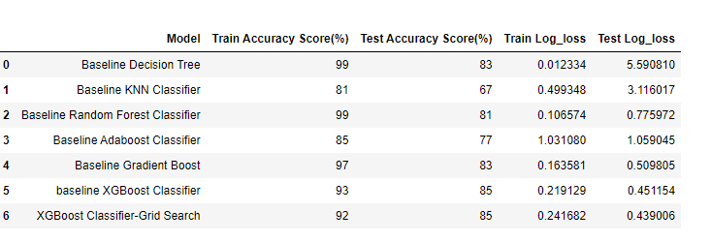
Modeling

Slide 7
Evaluation

Slide 8
Recommendations
The organization Zindi Africa should collect more data that features drug and alcohol related problems as well as other mental health problems that have not been featured in the observations used here.
The model be integrated into the chatbot prototype to carry out tests on actual university students and collect data on how it performed in classifying problems they were facing.

Slide 9
Recommendations
The chatbot should also feature a database containing resources and services available to the students based on the problem that the model was able to identify. This will ensure that actual help is availed to the user.

Slide 10
End of Presentation
Thank you and take care of your mental health
Alice
Eugene
Fridah
Keren
Nicholus
Nobert

